Slide 1
CA 7503 Software Testing

Slide 2
Lecture 8 : Static White-Box Testing

Slide 3
Introduction
Static white-box testing is the process of carefully and methodically reviewing the software design, architecture, or code for bugs without executing it. It’s sometimes referred to as structural analysis.
The unfortunate thing about static white-box testing is that it’s not always done.
Many teams have the misconception that it’s too time-consuming, too costly, or not productive.

Slide 4
Formal Reviews
A formal review is the process under which static white-box testing is performed. A formal review can range from a simple meeting between two programmers to a detailed, rigorous inspection of the code.

Slide 5
Formal Reviews
Four essential elements to a formal review
Identify Problems. The goal of the review is to find problems with the software—not just items that are wrong, but missing items as well. All criticism should be directed at the code, not the person who created it.
Follow Rules. A fixed set of rules should be followed. They may set the amount of code to be reviewed (usually a couple hundred lines), how much time will be spent (a couple hours), what can be commented on, and so on. This is important so that the participants know what their roles are and what they should expect. It helps the review run more smoothly.

Slide 6
Formal Reviews
Prepare. Each participant is expected to prepare for and contribute to the review. Depending on the type of review, participants may have different roles. They need to know what their duties and responsibilities are and be ready to actively fulfill them at the review. Most of the problems found through the review process are found during preparation, not at the actual review.
Write a Report. The review group must produce a written report summarizing the results of the review and make that report available to the rest of the product development team. It’s imperative that others are told the results of the meeting -how many problems were found, where they were found, and so on.

Slide 7
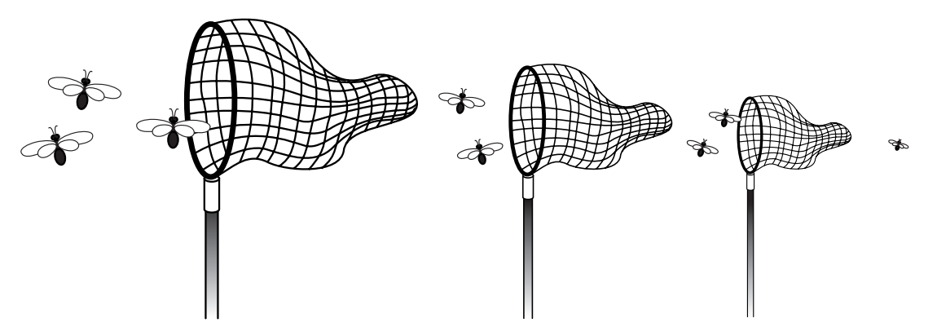
Formal Reviews
If the reviews are run properly, they can prove to be a great way to find bugs early.

Slide 8
Formal Reviews
In addition to finding problems, holding formal reviews has a few indirect results:
Communications. Information not contained in the formal report is communicated. For example, the black-box testers can get insight into where problems may lie. Inexperienced programmers may learn new techniques from more experienced programmers. Management may get a better feel for how the project is tracking its schedule.
Quality. A programmer’s code that is being gone over in detail, function by function, line by line, often results in the programmer being more careful. That’s not to say that he would otherwise be sloppy - just that if he knows that his work is being carefully reviewed by his peers, he might make an extra effort to triple-check it to make sure that it’s right.

Slide 9
Formal Reviews
Team Camaraderie. If a review is run properly, it can be a good place for testers and programmers to build respect for each other’s skills and to better understand each other’s jobs and job needs.
Solutions. Solutions may be found for tough problems, although whether they are discussed depends on the rules for the review. It may be more effective to discuss solutions outside the review.
These indirect benefits shouldn’t be relied on, but they do happen. On many teams, for whatever reasons, the members end up working in isolation.

Slide 10
Peer Reviews
The easiest way to get team members together and doing their first formal reviews of the software is through peer reviews, the least formal method. Sometimes called buddy reviews
Peer reviews are often held with just the programmer who wrote the code and one or two other programmers or testers acting as reviewers
To assure that the review is highly effective all the participants need to make sure that the four key elements of a formal review are in place: Look for problems, follow rules, prepare for the review, and write a report.
Because peer reviews are informal

Slide 11
Walkthroughs
Walkthroughs are the next step up in formality from peer reviews.
In a walkthrough, the programmer who wrote the code formally presents (walks through) it to a small group of five or so other programmers and testers.
The reviewers should receive copies of the software in advance of the review so they can examine it and write comments and questions that they want to ask at the review.
Having at least one senior programmer as a reviewer is very important.
The presenter reads through the code line by line, or function by function, explaining what the code does and why.
The reviewers listen and question anything that looks suspicious.

Slide 12
Inspections
Inspections are the most formal type of reviews.
They are highly structured and require training for each participant.
Inspections are different from peer reviews and walkthroughs in that the person who presents the code, the presenter or reader, isn’t the original programmer.
This forces someone else to learn and understand the material being presented
The other participants are called inspectors.

Slide 13
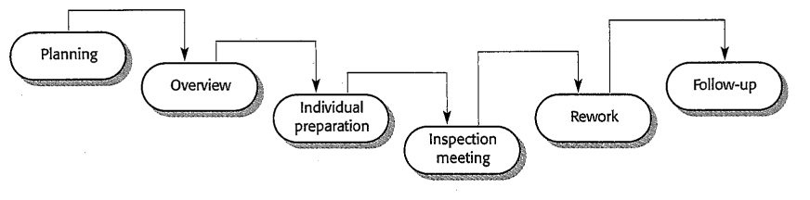
Inspection process

Slide 14
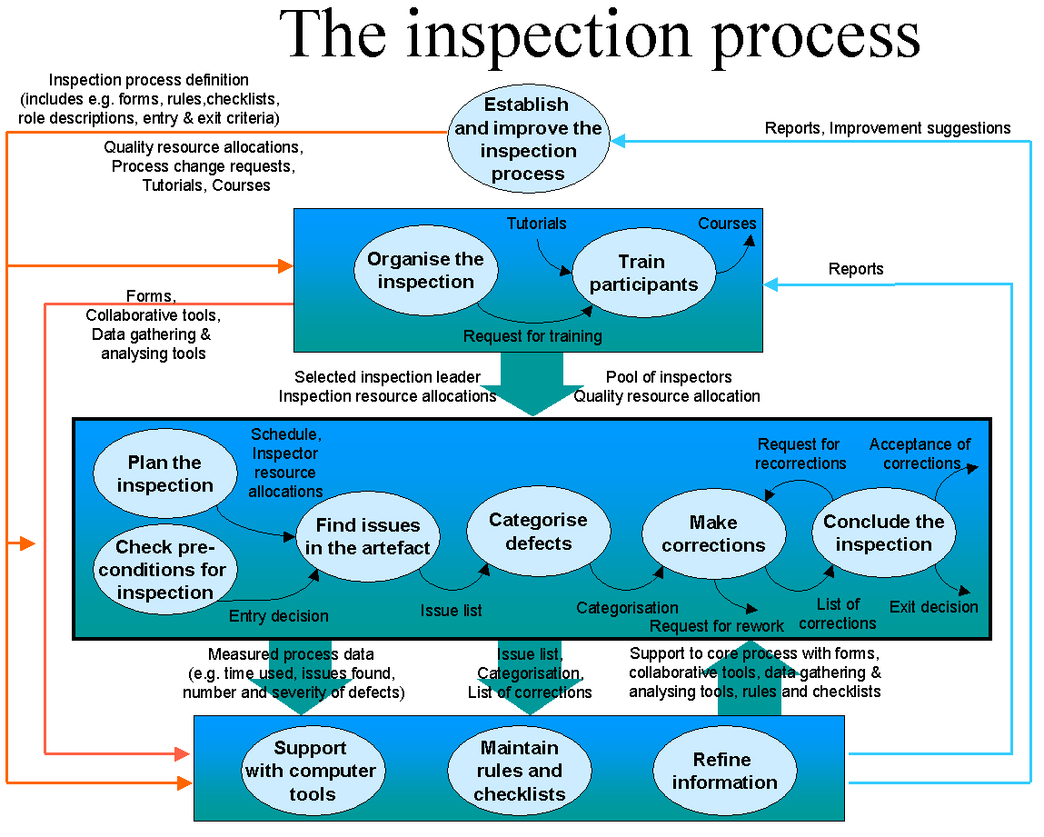

Slide 15
Inspections
Each is tasked with reviewing the code from a different perspective, such as a user, a tester, or a product support person.
Some inspectors are also assigned tasks such as moderator and recorder to assure that the rules are followed and that the review is run effectively.
After the inspection meeting is held, the inspectors might meet again to discuss the defects they found and to work with the moderator to prepare a written report that identifies the rework necessary to address the problems.

Slide 16
Inspection
What is inspection?
And what are the benefits?
When are inspections better than testing?
What kind of attributes?
What is the typical experience of firms with inspection?
Are there different kinds of inspections?
What are the relative benefits of each?
Who are the stakeholders in inspection?
What value is provided by each ?
How is the inspection process accomplished?
What are summary guidelines for the meetings?
What gets inspected?
And when to do inspections?

Slide 17
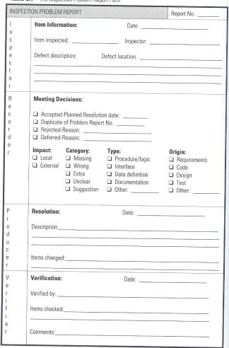
Inspection Report

Slide 18
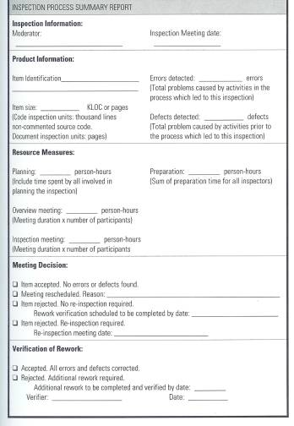
Inspection Report

Slide 19
Coding Standards and Guidelines
There are also problems where the code may operate properly but may not be written to meet a specific standard or guideline.
It’s equivalent to writing words that can be understood and get a point across but don’t meet the grammatical and syntactical rules of the English language.
Standards are the established, fixed, have-to-follow-them rules—the do’s and don’ts.
Guidelines are the suggested best practices, the recommendations, the preferred way of doing things.
Standards have no exceptions, short of a structured waiver process.
Guidelines can be a bit loose.

Slide 20
Coding Standards and Guidelines
Three reasons for adherence to a standard or guideline
Reliability. It’s been shown that code written to a specific standard or guideline is more reliable and bug-free than code that isn’t.
Readability/Maintainability. Code that follows set standards and guidelines is easier to read, understand, and maintain.
Portability. Code often has to run on different hardware or be compiled with different compilers. If it follows a set standard, it will likely be easier—or even completely painless—to move it to a different platform.

Slide 21
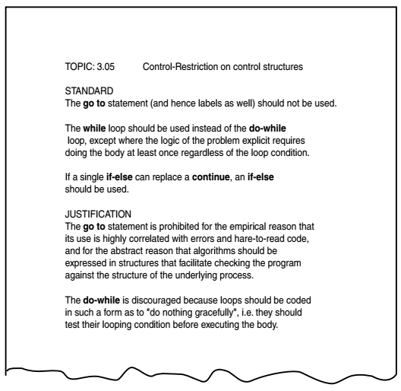
Example (Standard)

Slide 22
Standards
The standard has four main parts:
Title describes what topic the standard covers.
Standard (or guideline) describes the standard or guideline explaining exactly what’s allowed and not allowed.
Justification gives the reasoning behind the standard so that the programmer understands why it’s good programming practice.
Example shows simple programming samples of how to use the standard. This isn’t always necessary.

Slide 23
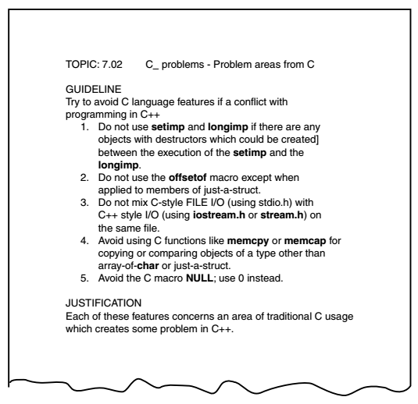
Example(Guideline)

Slide 24
Obtaining Standards
National and international standards for most computer languages and information technology can be obtained from:
American National Standards Institute (ANSI), www.ansi.org
International Engineering Consortium (IEC), www.iec.org
International Organization for Standardization (ISO), www.iso.ch
National Committee for Information Technology Standards (NCITS), www.ncits.org
There are also documents that demonstrate programming guidelines and best practices available from professional organizations such as
Association for Computing Machinery (ACM), www.acm.org
Institute of Electrical and Electronics Engineers, Inc (IEEE), www.ieee.org

Slide 25
Generic Code Review Checklist
These checklists are in addition to comparing the code against a standard or a guideline and to making sure that the code meets the project’s design requirements.
To really understand and apply these checks, you should have some programming experience.

Slide 26
Data Reference Errors
Data reference errors are bugs caused by using a variable, constant, array, string, or record that hasn’t been properly initialized
Is an uninitialized variable referenced? Looking for omissions is just as important as looking for errors.
Are array and string subscripts integer values and are they always within the bounds of the array’s or string’s dimension?
Are there any potential “off by one” errors in indexing operations or subscript references to arrays?
Is a variable used where a constant would actually work better—for example, when checking the boundary of an array?
Is a variable ever assigned a value that’s of a different type than the variable? For example, does the code accidentally assign a floating-point number to an integer variable?
Is memory allocated for referenced pointers?
If a data structure is referenced in multiple functions or subroutines, is the structure defined identically in each one?

Slide 27
Data Declaration Errors
Data declaration bugs are caused by improperly declaring or using variables or constants
Are all the variables assigned the correct length, type, and storage class? For example, should a variable be declared as a string instead of an array of characters?
If a variable is initialized at the same time as it’s declared, is it properly initialized and consistent with its type?
Are there any variables with similar names? This isn’t necessarily a bug, but it could be a sign that the names have been confused with those from somewhere else in the program.
Are any variables declared that are never referenced or are referenced only once?
Are all the variables explicitly declared within their specific module? If not, is it understood that the variable is shared with the next higher module?

Slide 28
Computation Errors
Computational or calculation errors are essentially bad math. The calculations don’t result in the expected result.
Do any calculations that use variables have different data types, such as adding an integer to a floating-point number?
Do any calculations that use variables have the same data type but are different lengths-adding a byte to a word, for example?
Are the compiler’s conversion rules for variables of inconsistent type or length understood and taken into account in any calculations?
Is the target variable of an assignment smaller than the right-hand expression?
Is overflow or underflow in the middle of a numeric calculation possible?

Slide 29
Computation Errors
Is it ever possible for a divisor/modulus to be zero?
For cases of integer arithmetic, does the code handle that some calculations, particularly division, will result in loss of precision?
Can a variable’s value go outside its meaningful range? For example, could the result of a probability be less than 0% or greater than 100%?
For expressions containing multiple operators, is there any confusion about the order of evaluation and is operator precedence correct? Are parentheses needed for clarification?

Slide 30
Comparison Errors
Less than, greater than, equal, not equal, true, false. Comparison and decision errors are very susceptible to boundary condition problems.
Are the comparisons correct? It may sound pretty simple, but there’s always confusion over whether a comparison should be less than or less than or equal to.
Are there comparisons between fractional or floating-point values? If so, will any precision problems affect their comparison? Is 1.00000001 close enough to 1.00000002 to be equal?
Does each Boolean expression state what it should state? Does the Boolean calculation work as expected? Is there any doubt about the order of evaluation?
Are the operands of a Boolean operator Boolean? For example, is an integer variable containing integer values being used in a Boolean calculation?

Slide 31
Control Flow Errors
Control flow errors are the result of loops and other control constructs in the language not behaving as expected. They are usually caused, directly or indirectly, by computational or comparison errors.
If the language contains statement groups such as begin...end and do...while, are the ends explicit and do they match their appropriate groups?
Will the program, module, subroutine, or loop eventually terminate? If it won’t, is that acceptable?
Is there a possibility of premature loop exit?
Is it possible that a loop never executes? Is it acceptable if it doesn’t?
If the program contains a multiway branch such as a switch...case statement, can the index variable ever exceed the number of branch possibilities? If it does, is this case handled properly?
Are there any “off by one” errors that would cause unexpected flow through the loop?

Slide 32
Subroutine Parameter Errors
Subroutine parameter errors are due to incorrect passing of data to and from software subroutines.
Do the types and sizes of parameters received by a subroutine match those sent by the calling code? Is the order correct?
If a subroutine has multiple entry points (yuck), is a parameter ever referenced that isn’t associated with the current point of entry?
If constants are ever passed as arguments, are they accidentally changed in the subroutine?
Does a subroutine alter a parameter that’s intended only as an input value?
Do the units of each parameter match the units of each corresponding argument- English versus metric, for example?
If global variables are present, do they have similar definitions and attributes in all referencing subroutines?

Slide 33
Input/Output Errors
These errors include anything related to reading from a file, accepting input from a keyboard or mouse, and writing to an output device such as a printer or screen. The items presented here are very simplified and generic.
Does the software strictly adhere to the specified format of the data being read or written by the external device?
If the file or peripheral isn’t present or ready, is that error condition handled?
Does the software handle the situation of the external device being disconnected, not available, or full during a read or write?
Are all conceivable errors handled by the software in an expected way?
Have all error messages been checked for correctness, appropriateness, grammar, and spelling?

Slide 34
Other Checks
This best-of-the-rest list defines a few items that didn’t fit well in the other categories.
Will the software work with languages other than English? Does it need to use Unicode instead of ASCII?
If the software is intended to be portable to other compilers and CPUs, have allowances been made for this?
Has compatibility been considered so that the software will operate with different amounts of available memory, different internal hardware such as graphics and sound cards, and different peripherals such as printers and modems?
Does compilation of the program produce any “warning” or “informational” messages?

Slide 35
Dynamic White-Box Testing versus Debugging
It’s important not to confuse dynamic white-box testing with debugging. If you’ve done some programming, you’ve probably spent many hours debugging code that you’ve written. The two techniques may appear similar because they both involve dealing with software bugs and looking at the code, but they’re very different in their goals
The goal of dynamic white-box testing is to find bugs.
The goal of debugging is to fix them.

Slide 36
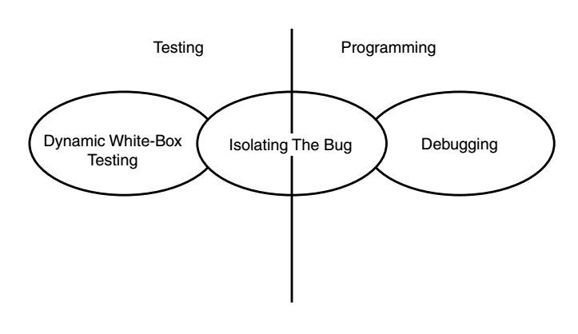
Dynamic White-Box Testing versus Debugging
Dynamic white-box testing and debugging have different goals but they do overlap in the middle

Slide 38
Data Coverage
The logical approach is to divide the code just as you did in black-box testing—into its data and its states (or program flow).
By looking at the software from the same perspective, you can more easily map the white-box information you gain to the black-box cases you’ve already written.
Consider the data first. Data includes all the variables, constants, arrays, data structures, keyboard and mouse input, files and screen input and output, and I/O to other devices such as modems, networks, and so on.

Slide 39
Data Flow
Data flow coverage involves tracking a piece of data completely through the software.
At the unit test level this would just be through an individual module or function.
The same tracking could be done through several integrated modules or even through the entire software product—although it would be more time-consuming to do so.

Slide 40
Data Flow Coverage
Considers how data gets accessed and modified in the system and how it can get corrupted
Common access-related bugs
Using an undefined or uninitialized variable
Assigning a value to a variable more than once without an intermediate access
Deallocating or reinitializing a variable before it is constructed, initialized, or used
Deleting a collection object leaving its members unaccessible (garbage collection helps here)

Slide 41
Data Flow Model
Two kinds of actions are considered:
Define: changes the value of an instance variable
Use: get the value of an instance variable without changing it
C-use: Used in an expression
P-use: Used inside a predicate
A data flow path is a control flow path that starts with a D and ends with (but does not include) a D

Slide 42
An Example
main() /* find longest line */
{
int len;
extern int max;
extern char save[];
A definition of len
Definitions of max
max = 0;
while ((len = getline ()) > 0)
A segment
if (len >= max) {
max = len;
A c-use of len
copy();
}
if (max > 0) /* there was a line */
printf("%s", save);
A decision predicate
involving max
}
A p-use of max
NB: In the example two additional define-use associations are not marked:
p-use of max in len >= max
p-use of len in len >= max

Slide 43
An OO Example
public void bar(int x) {
MyClass fred = new MyClass();
if (x > 0)
fred.setX(x);
int y = fred.getX();
}
Define action for fred
DD-path
Define action for fred
DU-path
Use action for fred

Slide 44
All-Defs Criterion
For every variable v
For every Define action d of v
There exists at least one test case that follows a path from d to a Use action of v

Slide 45
All-Uses Criterion
For every variable v
For every Define action d of v
For every Use action u of v
There exists at least one test case that follows a path from d to u

Slide 46
All-P-Uses / Some-C-Uses
For every variable v
For every Define action d of v
For every p-Use u of v
There exists at least one test case that follows a path from d to u
If there is no p-Use of v, there must exist at least one test case that follows a path from d to a c-Use of v

Slide 47
All-C-Uses / Some-P-Uses
For every variable v
For every Define action d of v
For every c-Use u of v
There exists at least one test case that follows a path from d to u
If there is no c-Use of v, there must exist at least one test case that follows a path from d to a p-Use of v

Slide 48
Data flow analysis issues
Aliasing of variables causes serious problems!
Working things out by hand for anything but small methods is hopeless
Compiler-based tools help in determining all DU paths

Slide 49
FAQ about Coverage
Is 100% coverage the same as exhaustive testing?
Are branch and path coverage the same?
Can path coverage be achieved?
Is every path in a flow graph testable?
Is less than 100% coverage acceptable?
Can I trust a test suite without measuring coverage?
When can I stop testing?

Slide 50
Some answers…
When you run out of time
When continued testing reveals no new faults
When you cannot think of any new test cases
When you reach a point of diminishing returns
When mandated coverage has been attained
When all faults have been removed

